Slide 1
The Lure of Debt: A Repubblican Defense of Independent Fiscal Institutions in the EMU
Stefano Merlo, MSc. M.A.
YSI Virtual Plenary
Notes:
Distributive implications =

Slide 2
Argument Outline
Democratic states exhibit a tendency to accumulate public debt over time threatening the long-term sustainability of the state.
Public Choice School Economists and Pettit (2004) claim that the best way to solve this is to depoliticize fiscal policy and leave to experts
I claim that this paradigm has strongly influenced the European Monetary Union governance framework of fiscal policy. Rules rule in the EMU.
A powerful defense of this system of governance is that it relies on the consent of all Member States. But the influence of this system can be justified only to the extent that it allows Member States to discharge their own obligations to their own publics

Slide 3
Argument Outline (Cont’)
One can interpret these obligations in a republican way (Pettit, 2012) as a requirement on the kind of relationship (i.e. a non-dominating one) the state should have towards its citizens
Fiscal policy decisions by a government can interfere in an arbitrary way with the choices that its own citizens make (i.e. vertical form of domination).
The existence of deficit bias speaks of normatively problematic information asymmetries between the people and their representatives, which, in turn, suggest that those republican obligations have not been fulfilled.
Independent Fiscal Councils (subject to supranational regulation) can reduce these information asymmetries and help citizens control executives’ choices in this policy area, thus making their interference non-arbitrary.

Slide 4
Economist and Democracy
Deficit Bias:
The tendency of governments to finance the yearly budget by borrowing from financial markets
Macroeconomic Perspective = Tension Between Two Goals:
Short-run business cycle stabilisation vs Long-term sustainability
Different Sources:
Political Business Cycle (Nordhaus, 1975 and Buchanan and Wagner 1977).
Common Pool Theory (Von Hagen and Harden,1995)
Competence Signalling (Rogoff and Siebert (1988)
Tie the hands of future governments (Alesina and Tabellini (1990) and Persson and Svenson (1989)
Notes:
even a well-orchestrated conduct of economic policy among states cannot shield from global external shocks that hit the Eurozone economies at the same time but in very different ways.
Coordination
Lead to goal achieve a non inflationary and balanced growth by smoothing the business cycle.
convergence among EMU countries by exploiting positive spillover effects and/or limiting negative ones
Are those solidarity actions?
economic policy coordination requires a shared understanding of the common goal and a commitment not to bypass each other’s will in its achievement
along with the fact of being part of the EMU impose significant costs on MS
All are for the overcoming of different adversities
Insurance:
Lead to goal by avoiding “bad equilibria” and break up

Slide 5
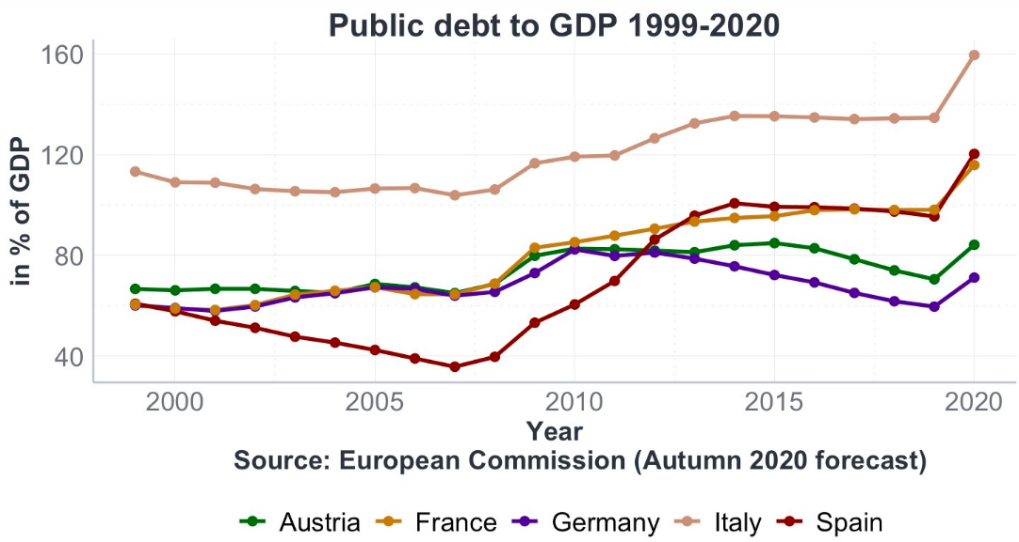
The Lure of Debt

Slide 6
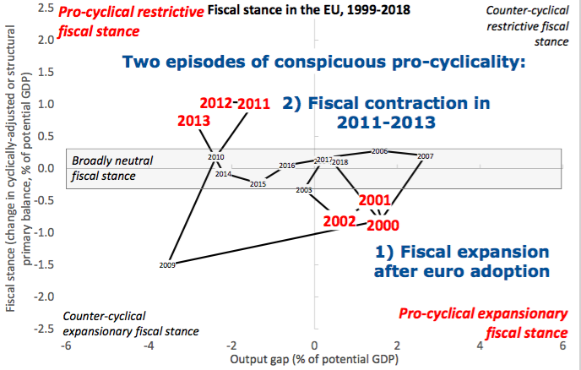
The Lure of Debt cont’

Slide 7
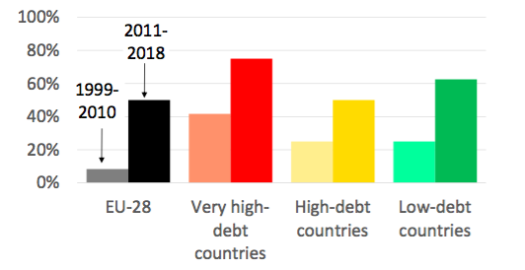
Frequency of fiscal policy in a pro-cyclical direction

Slide 8
Pettit (2004, 2001) & Depoliticisation
Electoral Interests and Deliberation:
““If a government faces a decision that will benefit one constituency over another and it has a powerful party-related interest in favoring one of them then there is little or no hope that it will be guided just by considerations of the common avowable good” (Pettit, 2001, 732). “
Solution:
"we should look to the possibility of depoliticizing the area of decision-making in question, thus allowing democracy to remain deliberative” (Pettit, 2004, 57)

Slide 9
Monetary Union: Rules Rule
Depoliticisation of Fiscal Policy:
Rule-Based framework to keep deficit and debt within bounds
Technical supervision by the DG-ECOFIN European Commission
Intergovernmental Decision making
🡪National Executives are at the top of the budgetary process, while parliaments’ role has been marginalized
Can the consent of Member States to this system of governance legitimate its outcomes?
- Lord (2017): Consent is legitimate only to the extent that the power vested in the Union are necessary for member states’ democracies to meet their own obligations toward their public.

Slide 10
Republican Obligations
Aim of Pettit (2012) : guarantee that citizens enjoy an “equal undominated status” in their relationship with the coercive state (Pettit, 2012, 147).
Two types of popular control over government:
Autorial
Editorial
Interpretation of deficit bias in Republican (Pettit, 2012) terms:
Asymmetric information on the part of both citizens and opposition parties 🡪 accountability gap

Slide 11
Fiscal Councils & The Democratic Promise of Expertise
Different sources of bias: i) political business cycles ii) common pool problems iii) signalling
Fiscal policy decisions may not be made subservient to citizen’s interests or responsive to citizens’ control and rather be used to further politicians’ own agendas.
Independent Fiscal Councils can reduce the information asymmetry between executives and voters by:
Carrying out ex-ante and ex-post analysis of fiscal solvency
Provide estimates of sustainability forecasts
Increase transparency of the budgetary process
Fiscal Councils’ expertise would elicit forms of reactive contestation that would preempt executives’ power abuses.

